Slide 1
NORTH SOUTH UNIVERSITY
Lecture 17
PHI 104
Introduction to Ethics
Spring Semester 2020

Slide 2
Beginning and End of Life Issues

Slide 3
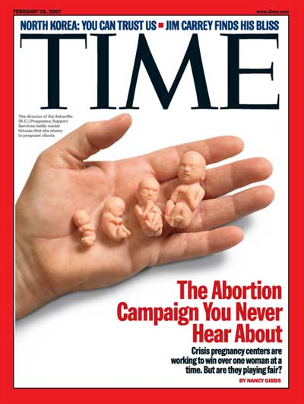

Slide 4
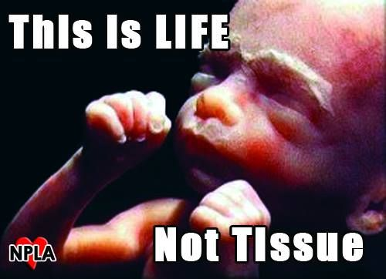

Slide 5


Slide 6
Bioethical issues related to Beginning of Life–Family planning, Abortion, prenatal testing, Assisted reproductive technology
Bioethical issues concerning End of Life–Euthanasia, Withdrawing and with holding treatment, Assisted suicide
Bioethical concerns related to sustaining Quality of Life – Organ and tissue Transplantation, Genetic engineering, human cloning

Slide 7
Ethical Issues-Family Planning
Refers to the various methods used to control the size of one’s family or to space birth.
The religious beliefs and personal values of individuals usually influence the methods and approaches used.

Slide 8
Ethical Issues-Abortion
Abortion was legalized in 1973, but the topic remains controversial.
The central ethical question in the abortion debate is over the moral status of the embryo and fetus.

Slide 9
Opinions range from the belief that the fetus is a human being with full moral status and rights from conception to the belief that a fetus has no rights, even if it is human in a biological sense. Most Americans’ beliefs fall somewhere in the middle.

Slide 10
Moral philosophers from various perspectives provide nuanced examinations of the abortion question that go beyond the standard political breakdowns.

Slide 11
Abortion has been the subject of much ethical thought from both pro-life and pro-choice perspectives. The central philosophical question concerns the moral status of the embryo and fetus. If the fetus is a person, with the same right to life as any human being who has been born, it would seem that very few, if any, abortions could be justified, because it is not morally permissible to kill children because they are unwanted or illegitimate or disabled.

Slide 12
However, the morality of abortion is not necessarily settled so straightforwardly. Even if one accepts the argument that the fetus is a person, it does not automatically follow that it has a right to the use of the pregnant woman’s body. Without that right, as Judith Thomson has argued, abortion could be justified.

Slide 13
Ethical Considerations
Public opinion on abortion falls into three camps—conservative, liberal, and moderate (or gradualist)—each of which draws on both science and ethical thinking.

Slide 14
Conservative’s Argument
(Pro-life)
Conservative
Conservatives regard the fetus as a human being, with the same rights as any human being who has been born, from implantation (when a pregnancy begins) onward. Some conservative groups—such as the Catholic Church—consider the fetus to be a human being with full moral rights even earlier, from conception onward.

Slide 15
Conception is regarded as the significant point because that is when the embryo develops its own unique genetic code, distinct from that of its mother or father, and thus from the egg or sperm.

Slide 16
The fetus changes dramatically during gestation but, on the conservative view, no stage is ever reached at which we can say, now we have a human being, whereas a day or a week or a month earlier we did not. Any attempt to place the onset of humanity at a particular moment—whether it be when brain waves appear, or the human form becomes distinct, or at quickening, sentience, or viability—is bound to be arbitrary because all of these stages will occur if the fetus is allowed to grow and develop.

Slide 17
Liberals Argument
(Pro-choice)
Most liberals acknowledge that the fetus is human in a biological sense, but deny that this endows the fetus with full moral status or a right to life. In 1971, Judith Thomson gave a completely different pro-choice argument, claiming that even if the personhood of the fetus were granted, this would not settle the morality of abortion because the fetus’s right to life does not necessarily give it a right to use the pregnant woman’s body.

Slide 18
No one, Thomson says, has the right to use your body unless you give him permission—not even if he needs it for life itself. At least in the case of rape, the pregnant woman has not given the fetus the right to use her body.

Slide 19
Judith Thomson, “A Defense of Abortion,” Philosophy and Public Affairs, Winter 1971
Thomson maintains that whether a woman ought to allow a fetus to remain in her body is a separate question from whether the fetus is a person with a right to life, and depends instead on the amount of sacrifice or burden it imposes on her.

Slide 20
Prenatal Testing
Sonography and other techniques to detect genetic abnormalities.
Ethical concern:
Govt. may make amniocentesis n abortion of all defective fetuses mandatory.
Couples may be stressed as carrying defective gene.

Slide 21
Assisted Reproductive Technology (ART)
The IVF technology is a boon to childless couples.
The purpose of this procedure is to achieve fertilization and pregnancy.
The first IVF baby - Louse Joy Brown, who was born on July 25, 1978.

Slide 22
Ethical Issues
Woman may have multiple births as several fertilized ova are developed to ensure that at least one will survive.
At times this lead to abortion leading to financial and emotional costs.
What to be done with fertilized ova that are not successful?
Donate, freeze (how long) or thrown away (abortion)?

Slide 23
End of life issues
Euthanasia

Slide 24
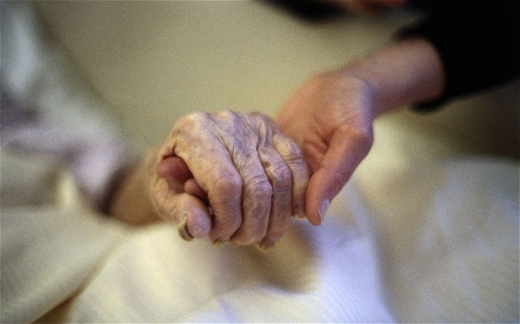

Slide 25
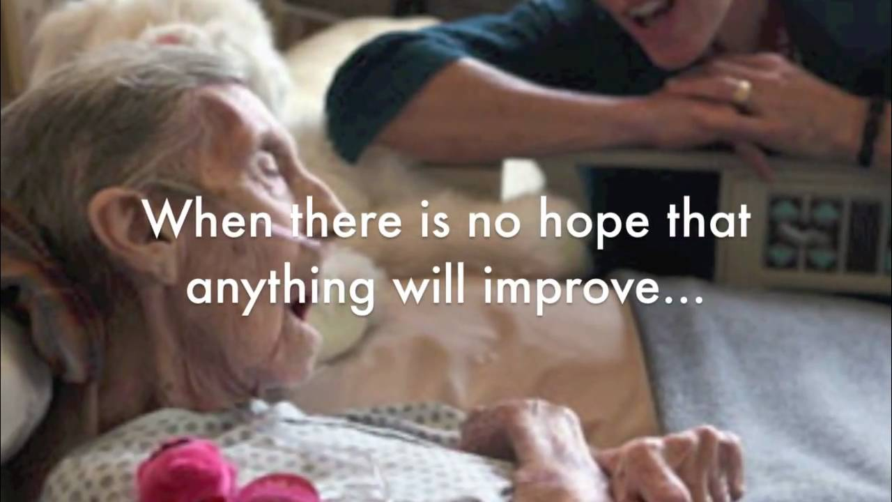

Slide 26
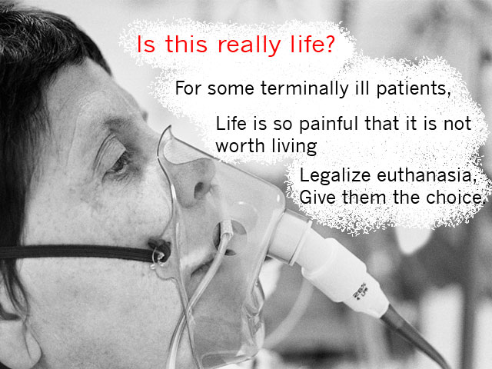

Slide 27


Slide 28


Slide 29
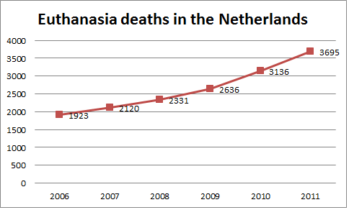

Slide 30
Euthanasia
Euthanasia is the act of deliberately ending a person's life to relieve suffering.
For example, a doctor who gives a patient with terminal cancer an overdose of muscle relaxants to end their life would be considered to have carried out euthanasia.

Slide 31
Assisted suicide is the act of deliberately assisting or encouraging another person to kill themselves.
If a relative of a person with a terminal illness were to obtain powerful sedatives, knowing that the person intended to take an overdose of sedatives to kill themselves, they may be considered to be assisting suicide.

Slide 32
English Law
Both active euthanasia and assisted suicide are illegal under English law.
Depending on the circumstances, euthanasia is regarded as either manslaughter or murder and is punishable by law, with a maximum penalty of up to life imprisonment.
Assisted suicide is illegal under the terms of the Suicide Act (1961) and is punishable by up to 14 years' imprisonment. Attempting to kill yourself is not a criminal act in itself.

Slide 33
Other countries
Active euthanasia is currently only legal in Belgium, Holland and Luxembourg. Under the laws in these countries, a person’s life can be deliberately ended by their doctor or other healthcare professional.
The person is usually given an overdose of muscle relaxants or sedatives. This causes a coma and then death.

Slide 34
However, euthanasia is only legal if the following three criteria are met:
The person has made an active and voluntary request to end his life.
It is thought that they have sufficient mental capacity to make an informed decision regarding their care.
It is agreed that the person is suffering unbearably and there is no prospect for an improvement in his condition.
Capacity is the ability to use and understand information to make a decision. Read more about the capacity to consent to treatment.

Slide 35
In some countries the law is less clear, with some forms of assisted suicide and passive euthanasia legal, but active euthanasia is illegal.
For example, some types of assisted suicide and passive euthanasia are legal in Switzerland, Germany, Mexico and five American states.

Slide 36
Types of Euthanasia
Euthanasia can be classified in different ways, including:
active euthanasia – where a person deliberately intervenes to end someone’s life – for example, by injecting them with a large dose of sedatives
passive euthanasia – where a person causes death by withholding or withdrawing treatment that is necessary to maintain life, such as withholding antibiotics from someone with pneumonia.

Slide 37
Euthanasia can also be classified as:
voluntary euthanasia – where a person makes a conscious decision to die and asks for help to do this
non-voluntary euthanasia – where a person is unable to give their consent (for example, because they are in a coma or are severely brain damaged) and another person takes the decision on their behalf, often because the ill person previously expressed a wish for their life to be ended in such circumstances
involuntary euthanasia – where a person is killed against their expressed wishes

Slide 38
Depending on the circumstances, voluntary and non-voluntary euthanasia could be regarded as either voluntary manslaughter (where someone kills another person, but circumstances can partly justify their actions) or murder.
Involuntary euthanasia is almost always regarded as murder.
There are arguments used by both supporters and opponents of euthanasia and assisted suicide.

Slide 39
Next Lecture
Arguments for and against euthanasia and assisted suicide

Slide 40
Thanks
THANK YOU!!!

